Slide 1
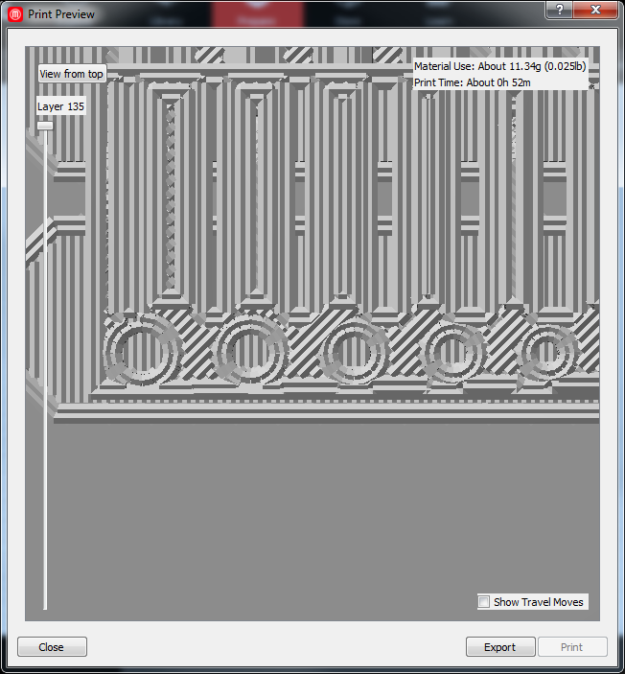
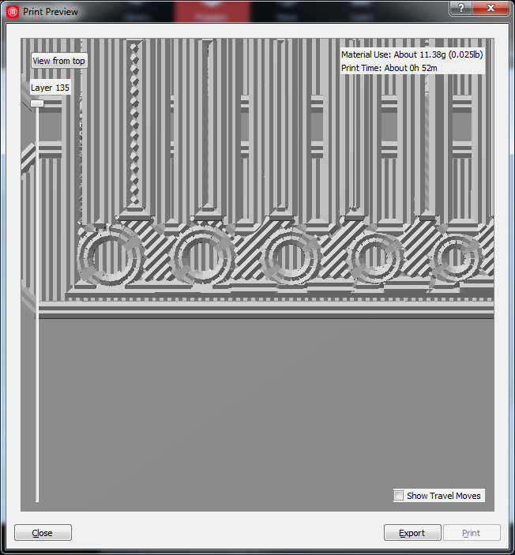
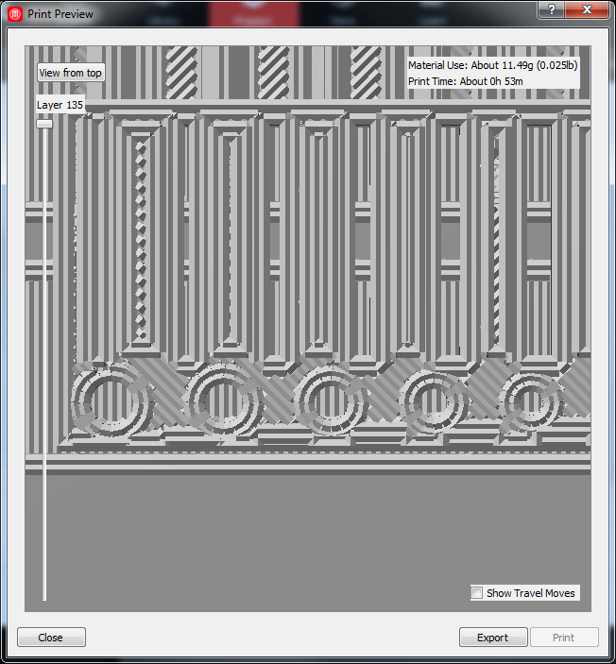
Layer Height modulus for core and its effect on radius reproduction
coreHeight = 8.175
coreHeight = 8.2
coreHeight = 8.3

Slide 2
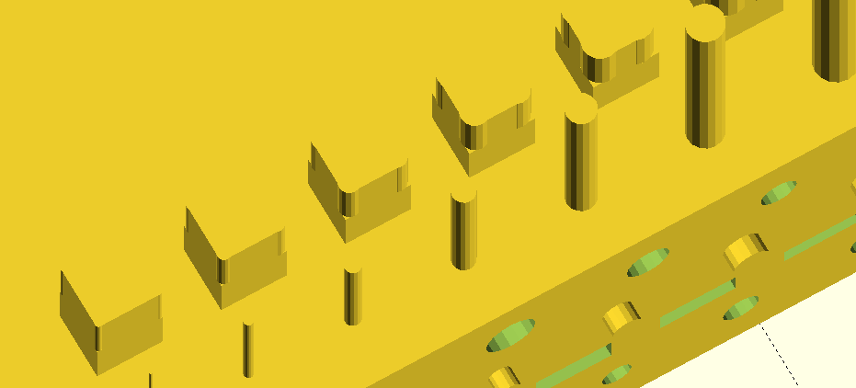
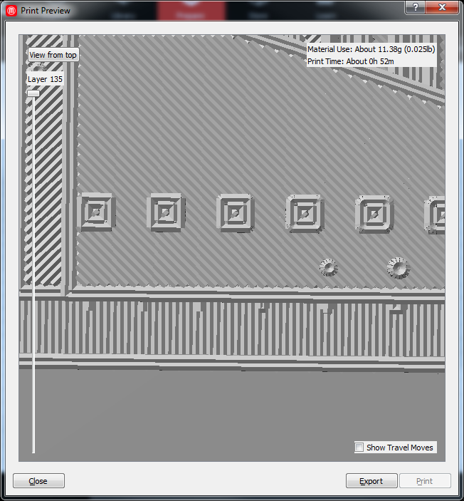
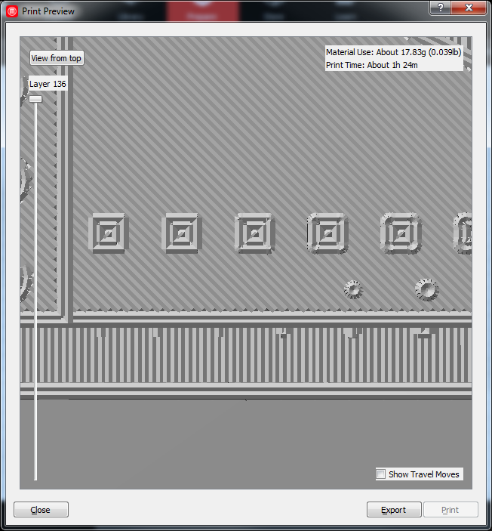
Popping out the corners on xy fillets by 10%
Not pushed out
pushed out

